Slide 1
Stonks
Market
12/02/2024
Maxim Dokukin, Ryan Fernald, Sean Hsieh, Ashkan Nikfarjam, Varun Ranjan

Slide 2
Problem Statement
Managing stock investments is complex for beginners.
Real trading involves financial risk, deterring learning.
Lack of virtual platforms for simulated trading of real market data.
Research shows that 97% of Brazilian day traders lost money over a 300-day period, highlighting the challenges faced by inexperienced traders (Business Insider).

Slide 3
The Solution
Virtual Trading System:
Learn trading with no real risk.
Features:
Real-time S&P 500 stock data.
Virtual dollar wallet for risk-free investments.
Analytics to track performance and simulate strategies.
Key Benefit:
Build trading skills in a real-market environment without financial loss.

Slide 4
Key Features and Functionality
User Management:
Sign up and maintain balances in virtual dollars.
Stock Market Trading:
Buy/Sell stocks using S&P 500 tickers.
Track market prices and performance.
Historical Prices: View price trends for better decisions.
Watchlist:
Track favorite stocks.
Virtual Wallet:
Deposit/withdraw funds.
Record transactions securely.
News Section:
Keep up-to-date with market news.

Slide 5
Application Architecture
Frontend:
React (user interface).
Backend:
Flask API for data management.
Database:
MySQL with BCNF schema.
Workflow:
Users interact with frontend.
Backend processes requests and updates the database.
Data pulled from a mock S&P 500 data source (e.g., API integration or stored tables).

Slide 6
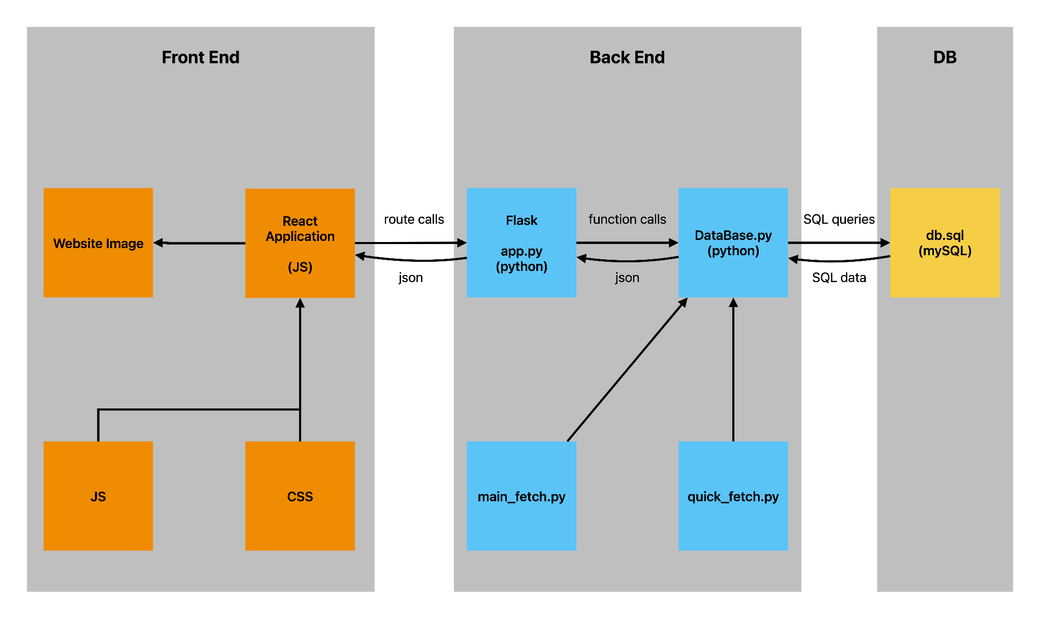

Slide 7
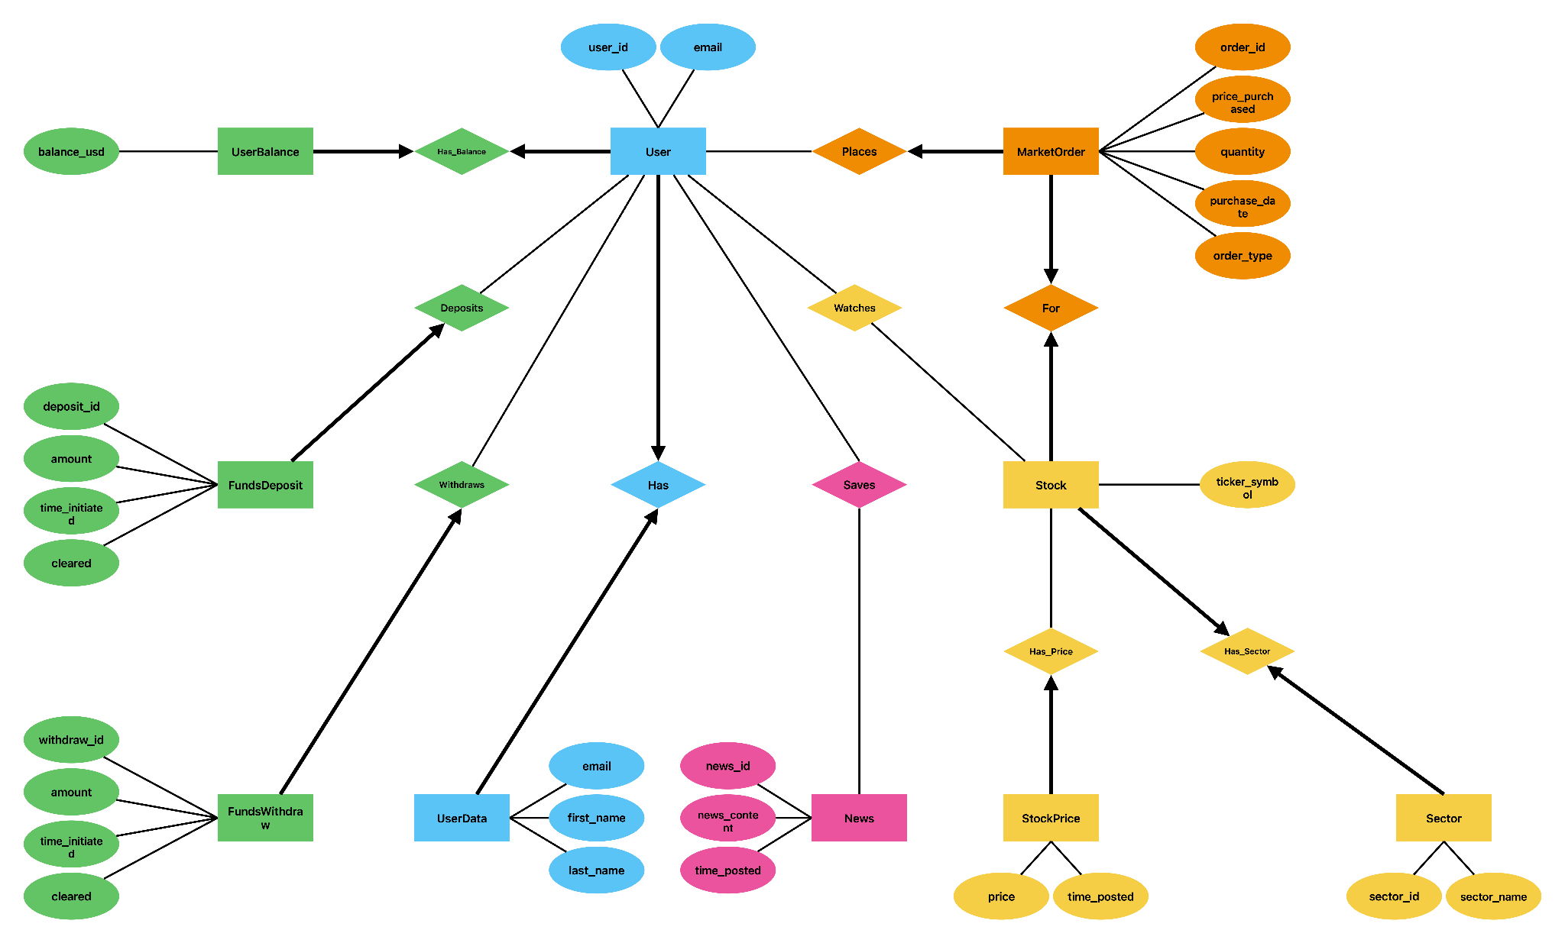
Sql diagram

Slide 8
Major Design Decisions
Database Normalization:
Ensured BCNF for consistency.
Tables: User, Stock, MarketOrder, UserBalance, Watchlist.
Frameworks:
React for responsiveness.
Flask for modular API.
Mock Real-Time Data:
Stock prices stored and updated in StockPrice.
Scalability:
Used cascading rules to handle deletions (e.g., SET NULL for dependent entries).

Slide 9
Application Demo
Sign Up and Login:
Create a user (user_id, email).
Add funds to virtual wallet using FundsDeposit.
Trade Stocks:
Place a BUY order.
View updated portfolio in UserBalance and MarketOrder.
Track Stocks:
Add a stock to the Watchlist.
Check price trends in StockPrice.
Market News:
Save a news article to SavedNews.

Slide 10
Challenges Encountered
Database Normalization:
Ensured no redundancy while maintaining relationships.
Cascading Effects:
Handling foreign key constraints for MarketOrder and Watchlist.
API Integration:
Mocking real-time S&P 500 data.
User Wallet Updates:
Ensured atomicity in deposits, withdrawals, and transactions.

Slide 11
Future Work
Real-Time Data:
Integrate with live S&P 500 APIs.
Advanced Analytics:
Portfolio performance.
Risk assessment tools.
Gamification:
Leaderboards and rewards for user engagement.
Enhanced Security:
Implement two-factor authentication.

Slide 12
Conclusion
"Our platform bridges the gap between theory and practice, making stock trading accessible, safe, and fun."
Achievements:
Fully functional virtual trading system.
Interactive user interface.
Reliable backend with normalized data.
Thank your audience!
Questions?

